Slide 1
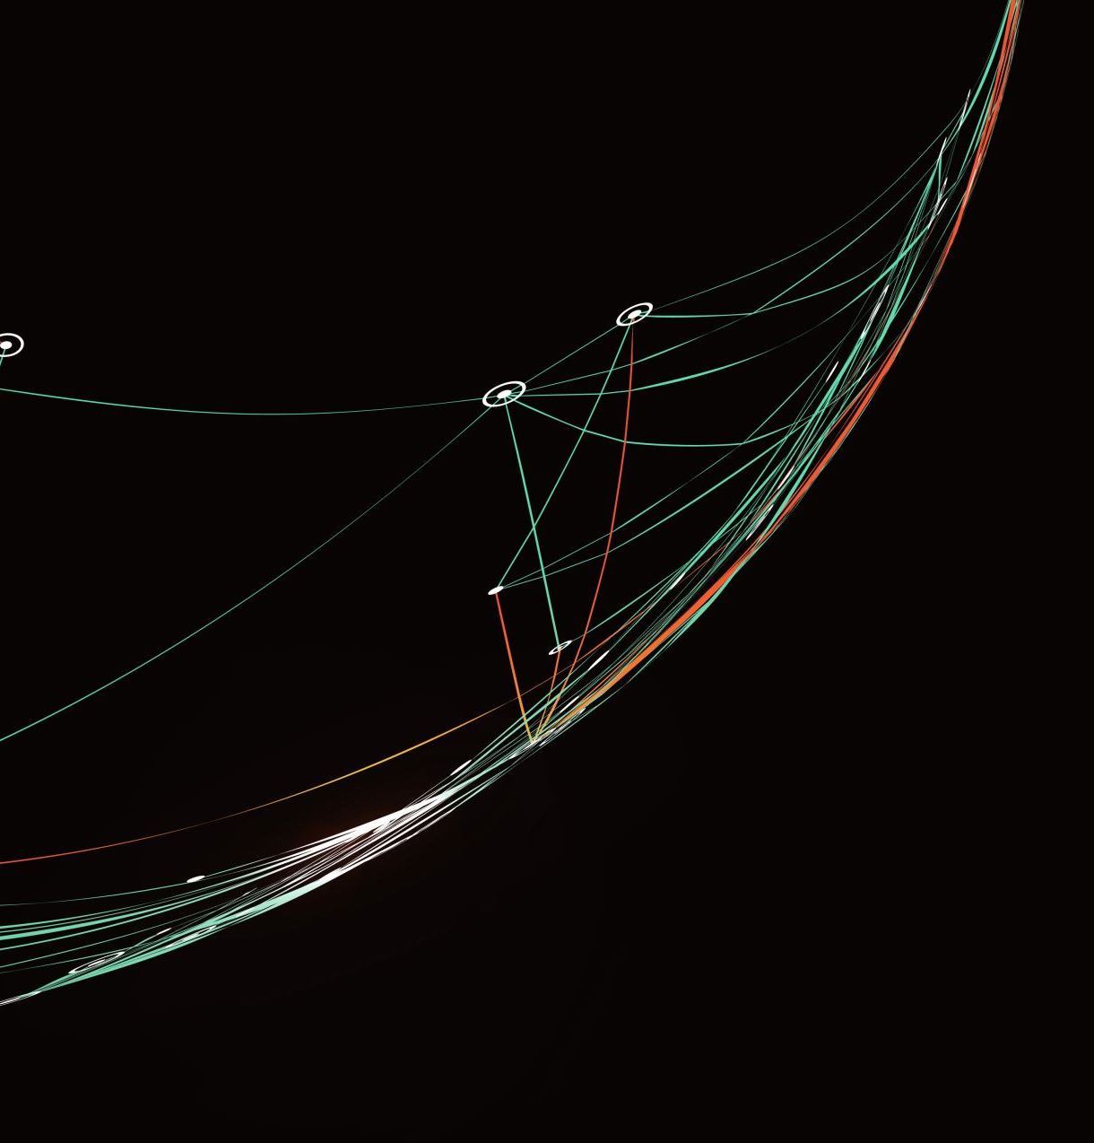
Speech Emotion Recognition

Slide 2
AGENDA
Introduction to Speech Emotion Recognition
Data Collection and Preprocessing
Feature Extraction Techniques
Model Selection and Techniques
Results and Analysis
Data Augmentation Techniques

Slide 3
Introduction to speech emotion recognition
Introduction:
Emotion recognition is crucial in various applications, including mental health monitoring, enhancing customer service experiences and improving interactions with AI systems.
Key Applications:
Mental Health Monitoring: Identifying emotional states can aid in assessing mental health conditions.
Customer Service: Emotion recognition can enhance user interactions, leading to improved customer satisfaction.
AI Development: Integrating emotion recognition into AI systems can create more empathetic and responsive interfaces.

Slide 4
Data collection and preprocessing
Dataset overview:
Crema
Ravdess
Savee
Tess
Each dataset contains audio files in .wav format, categorized with primary emotional labels.

Slide 5
Data preprocessing steps
Loading the dataset
Mapping emotions
Waveform visualization

Slide 6
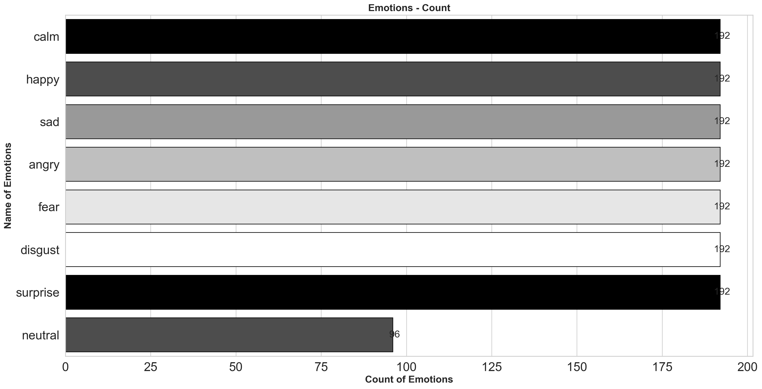
After plotting the details of dataset.

Slide 7
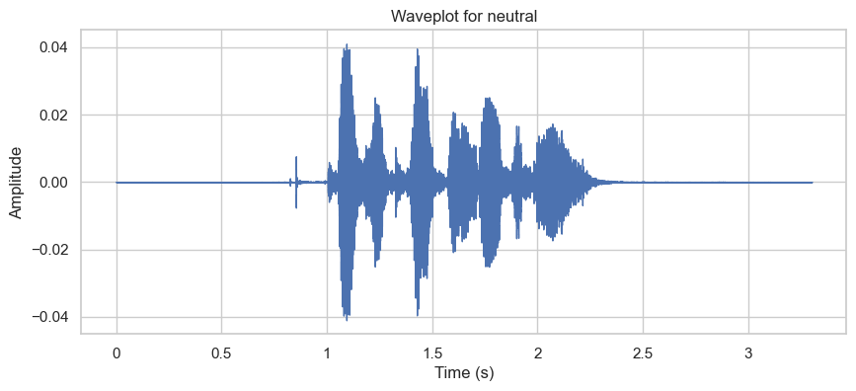
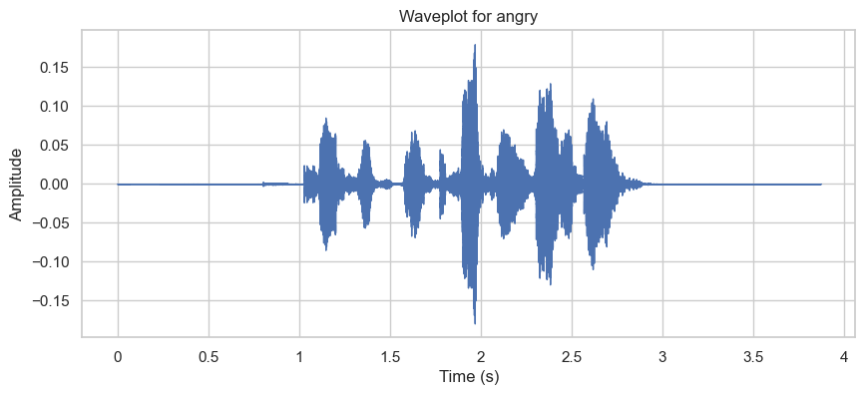
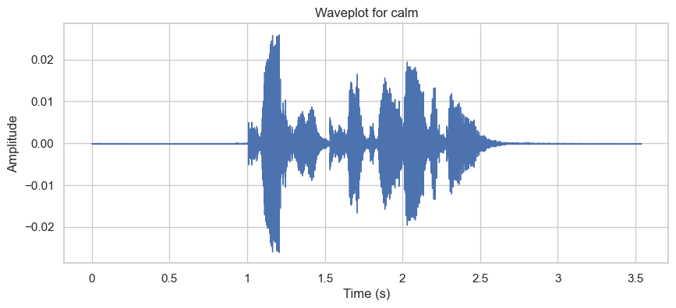
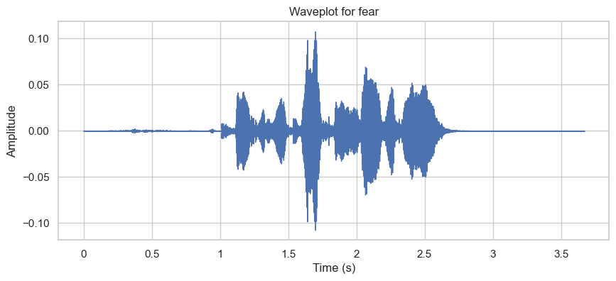
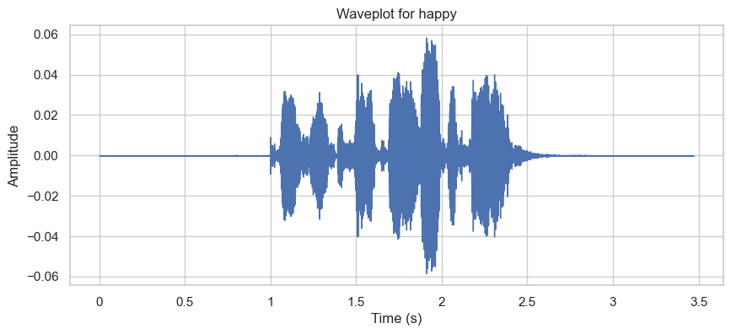
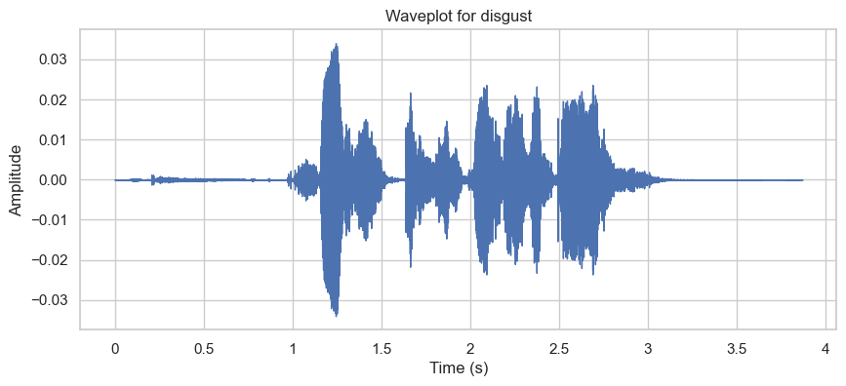
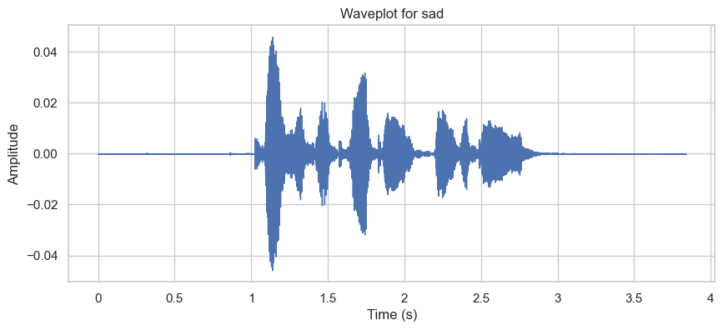
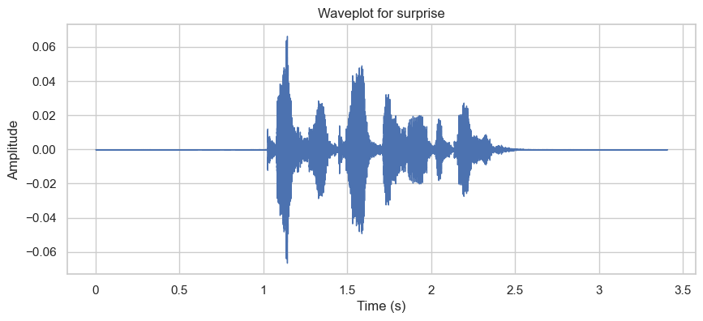

Slide 8
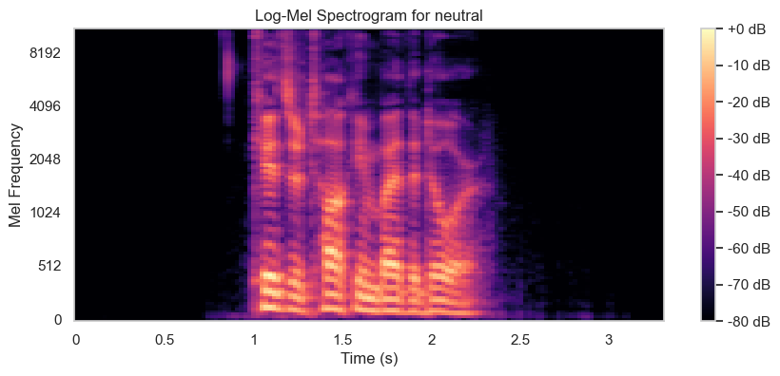
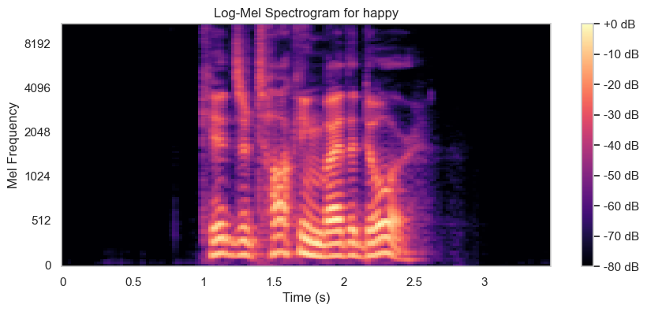
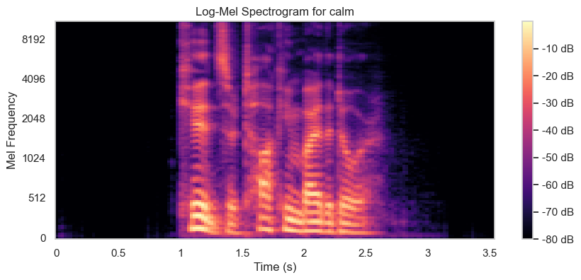
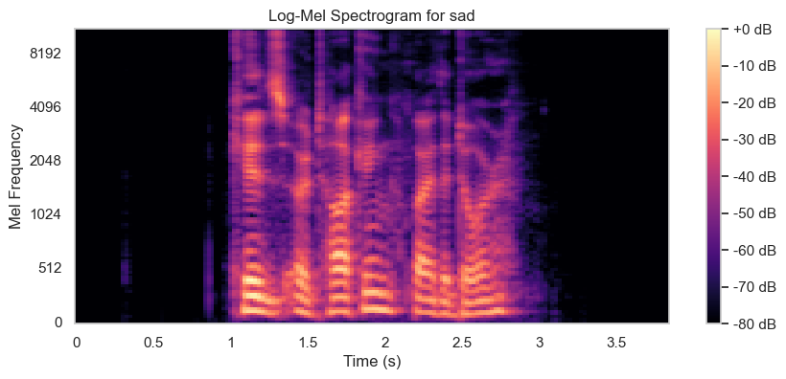

Slide 9
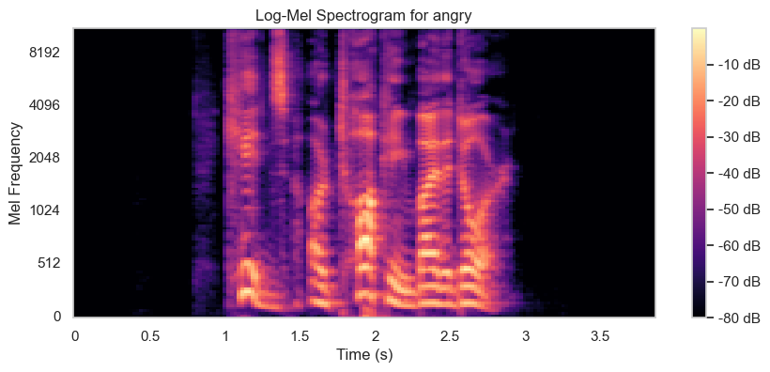
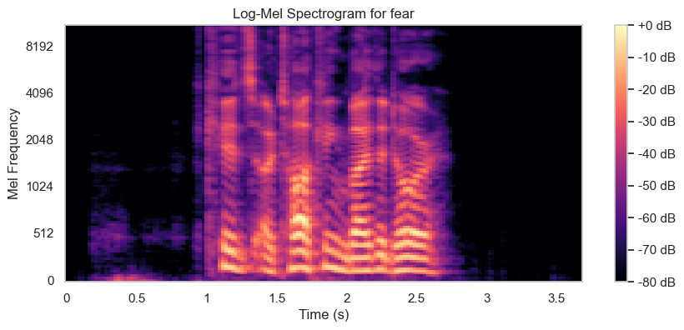
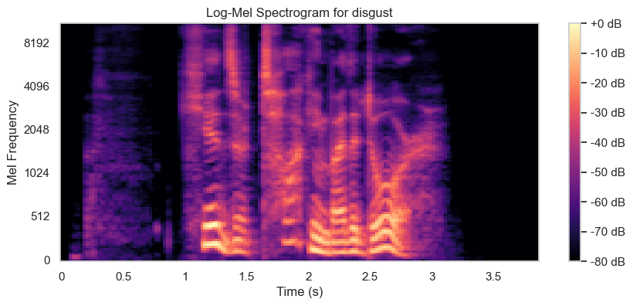
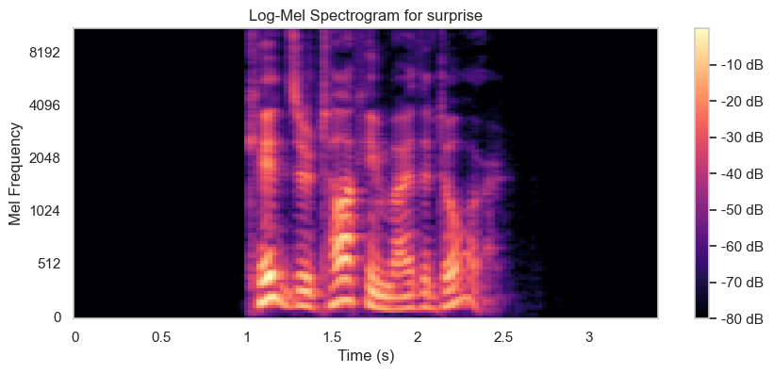

Slide 10
Feature extraction
Function definition
Implementation
Result

Slide 11
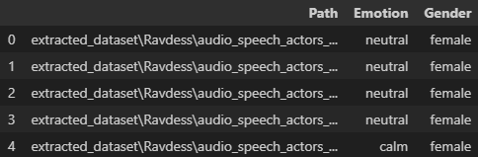
After extracting emotion and gender label

Slide 12
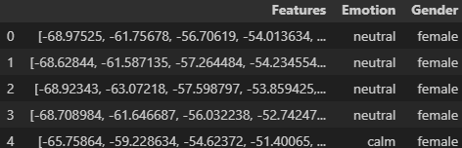
Averaged spectrogram values loaded into new data frame

Slide 13
Model training
Feature conversion
Label encoding
Separation of features and labels
Train-test split
Normalization process

Slide 14
Final shapes of encoded labels
y_emotion_train_encoded shape | (1152,)
y_emotion_test_encoded shape | (288,)
y_gender_train_encoded shape | (1152,)
y_gender_test_encoded shape | (288,)

Slide 15
Reshaping to 3d tensors
X_train_cnn shape: | (1152, 128, 1)
X_test_cnn shape: | (288, 128, 1)

Slide 16
Model evaluation results
Dummy Classifier:
Accuracy: 11.46%
Decision Tree Classifier:
Accuracy: 31.25%

Slide 17
Implementation of 1d CNN model
1D CNN Model Summary
Model Overview
Type: Sequential Model
Total Parameters: 45,384
Trainable Parameters: 45,384
Non-Trainable Parameters: 0

Slide 18
Layer breakdown
Layer Type | Output Shape | Parameters
Convo1D (Layer 1) | (None, 126, 32) | 128
MaxPoolingID | (None, 63, 32) | 0
Dropout | (None, 63, 32) | 0
Convo1D (Layer 2) | (None, 61, 64) | 6,208
MaxPoolingID | (None, 30, 64) | 0
Dropout | (None, 30, 64) | 0
Convo1D (Layer 3) | (None, 28, 128) | 24,704
MaxPoolingID | (None, 14, 128) | 0
Dropout | (None, 14, 128) | 0
Flatten | (None, 1792) | 0
Dense | (None, 8) | 14,344

Slide 19

Results and analysis

Slide 20

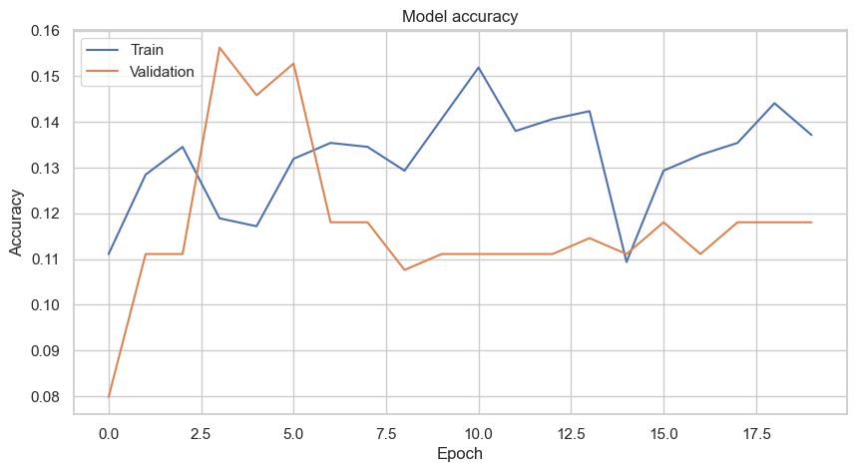
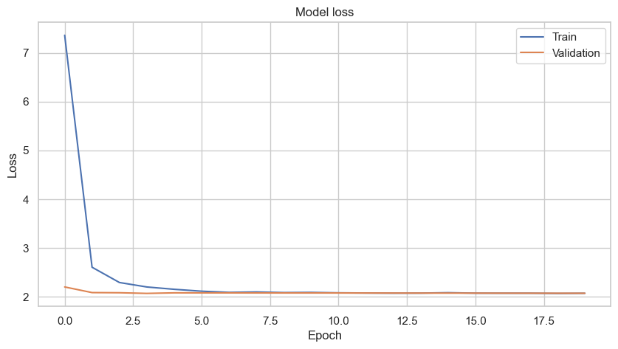
Plotting training and accuracy values
Test Accuracy: 0.1180555522441864
Test Loss: 2.07067608833313
This Photo by Unknown Author is licensed under CC BY-SA

Slide 21

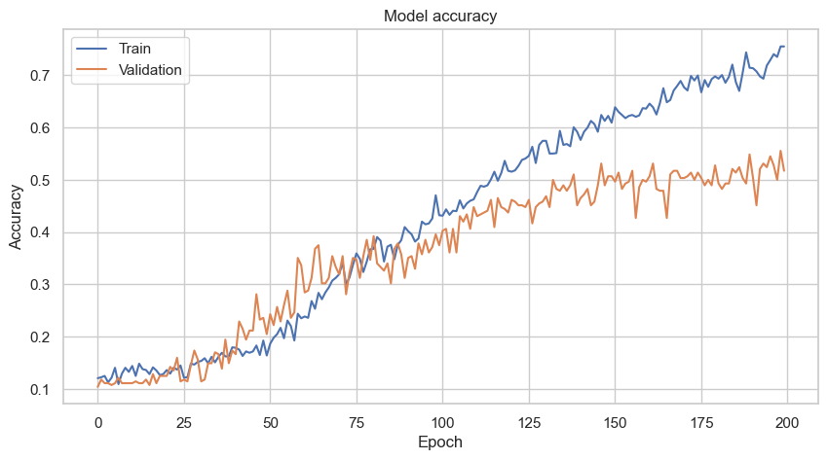
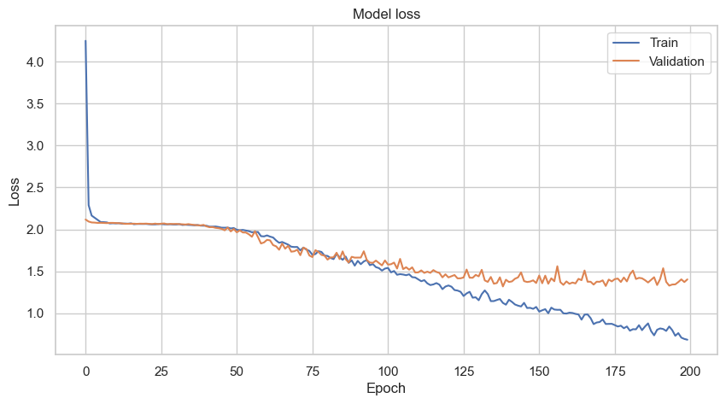
After increasing the epochs value
Test Accuracy: 0.5173611044883728
Test Loss: 1.4047685861587524

Slide 22
Data augmentation
Adding guassian noise to audio
Applying Time Stretch
Increasing Speed and pitch

Slide 23
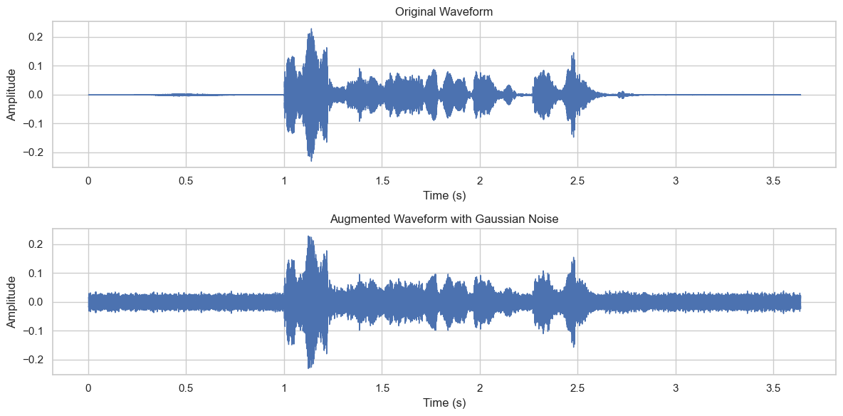

Slide 24
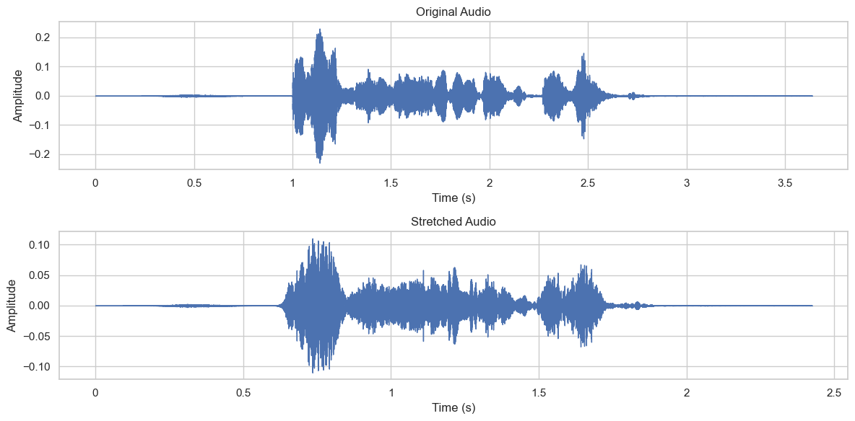

Slide 25
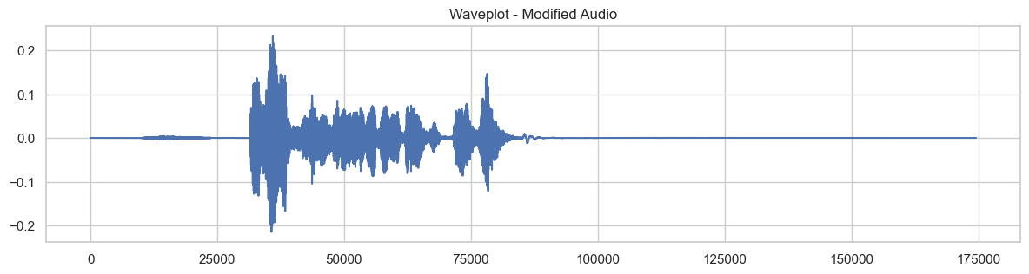
After applying speed and pitch

Slide 26
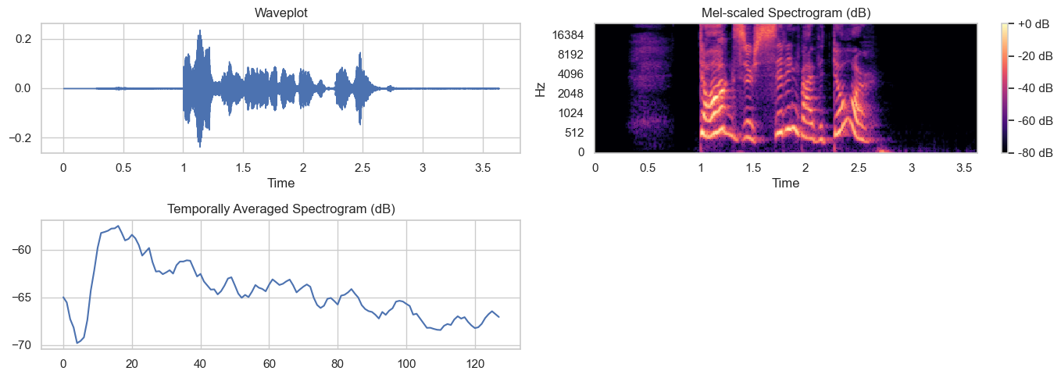

Slide 27
Classification report
 | Precision | Recall | F1-score | support
Angry | 0.82 | 0.67 | 0.74 | 42
Calm | 0.59 | 0.82 | 0.69 | 44
Disgust | 0.50 | 0.81 | 0.62 | 32
Fear | 0.69 | 0.69 | 0.69 | 32
Happy | 0.43 | 0.38 | 0.41 | 34
Neutral | 0.69 | 0.55 | 0.61 | 20
Sad | 0.67 | 0.56 | 0.61 | 39
Surprise | 0.80 | 0.53 | 0.64 | 45
Accuracy |  |  | 0.63 | 288
Macro Avg | 0.65 | 0.63 | 0.62 | 288
Weighted Avg | 0.66 | 0.63 | 0.63 | 288

Slide 28
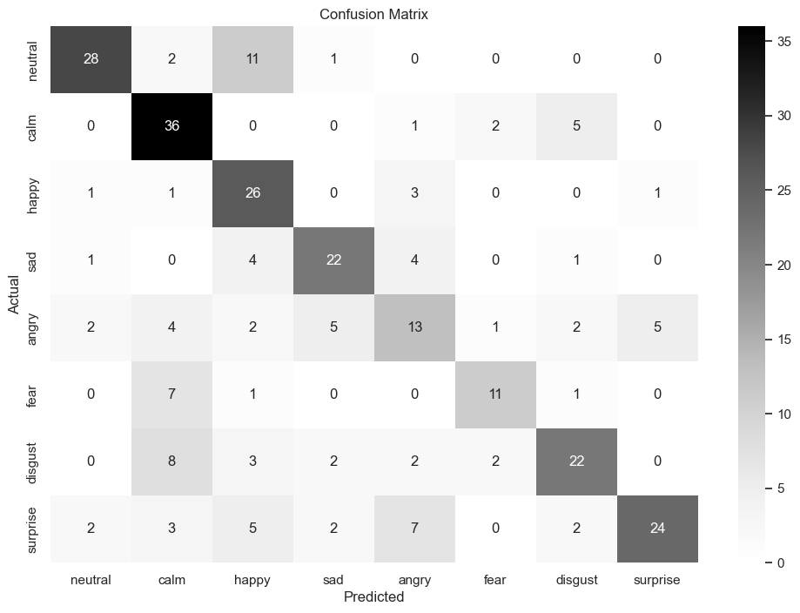

Slide 29
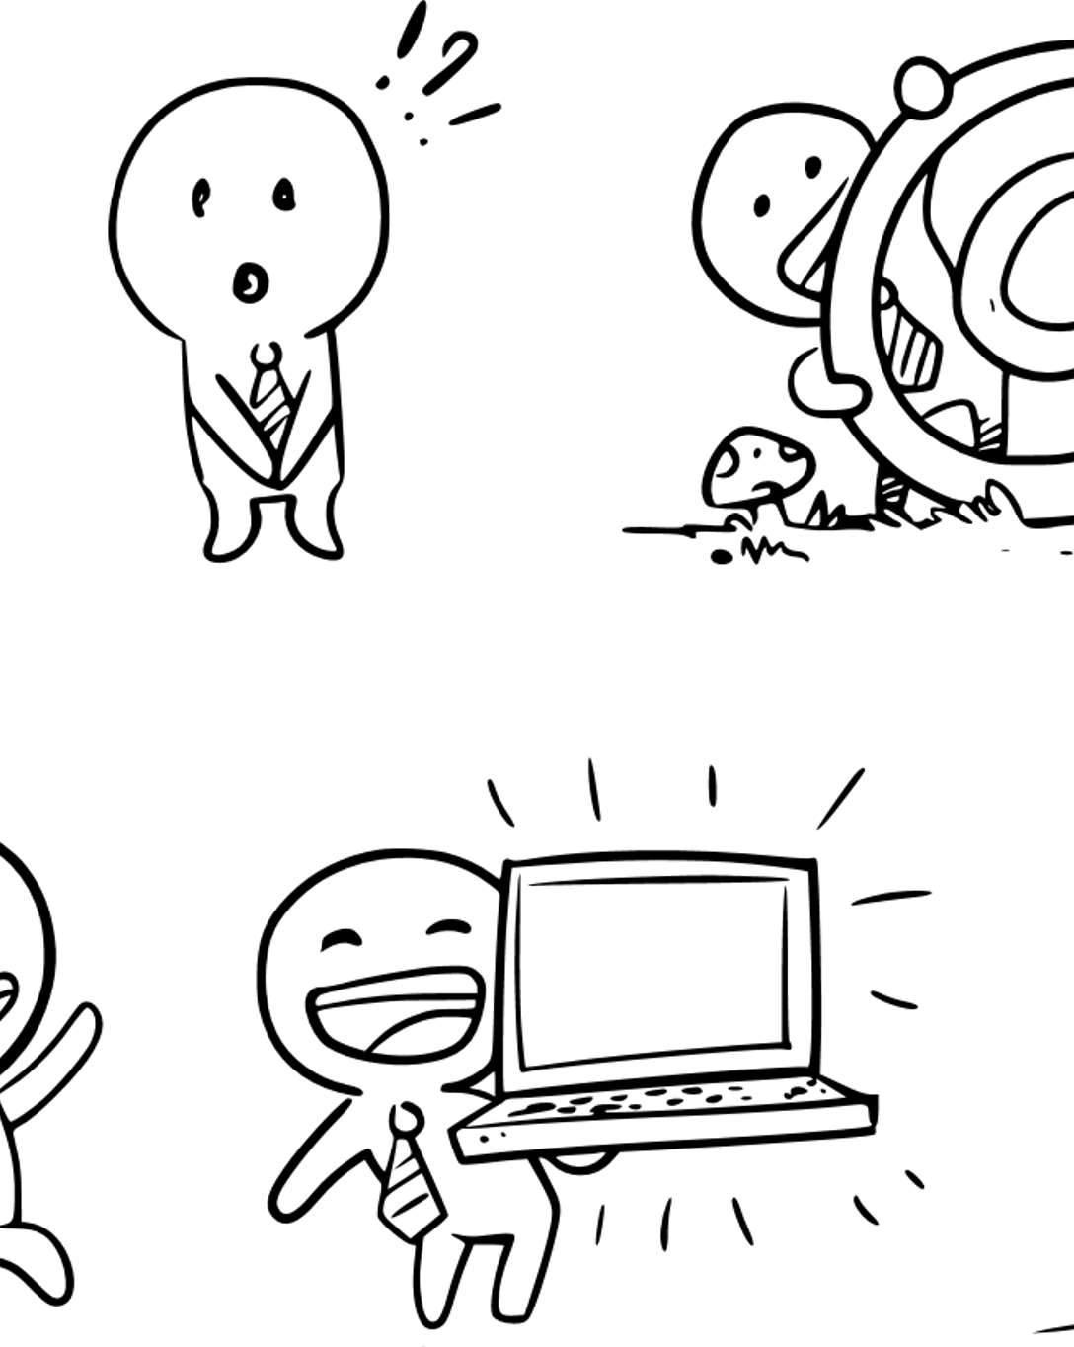
Dobzhansky Template
Nothing in emotion recognition makes sense except in the light of machine learning and audio processing techniques

Slide 30

And-but-therefore technique
This Photo by Unknown Author is licensed under CC BY-NC

Slide 31

The hero’s journey
Introduction
Challenges
Transformation
outcome
This Photo by Unknown Author is licensed under CC BY-NC

Slide 32
THANK YOU
Krishna Ghanghar

